Slide 1
State of the Chapter
2022

Slide 2
Agenda
2021 Wins
Financials
Membership
Board of Directors
Opportunities
2022 Plans

Slide 3
2021 CHAPTER WINS
1
12-month Journey Map
2
New Member Onboarding Program
3
ATD Capability Model Programming
4
Created ATD San Diego Podcast
5
Produced a monthly President’s vLOG
6
Achieved CARE Plus status
Notes:
What you've enjoyed in your role as Director
4 tasks or processes that you do in your role - use for State of the Chapter volunteer opportunities - add to the Drive - ask someone to create a doc in the shared drive - capture in chat?

Slide 4
6
Chapter
Meetings
4
In-Person
Mixers
Storyline
Workshops
10

Slide 5
8
SoCal Young Professionals SIG
4
Discover the Benefits of Membership
3
Workshops

Slide 6
2021 Financials
Total Income
$14,724
Expenses
$14,592
Net Income
$377

Slide 7
Membership
2021
135
2020
150
149
2019

Slide 8
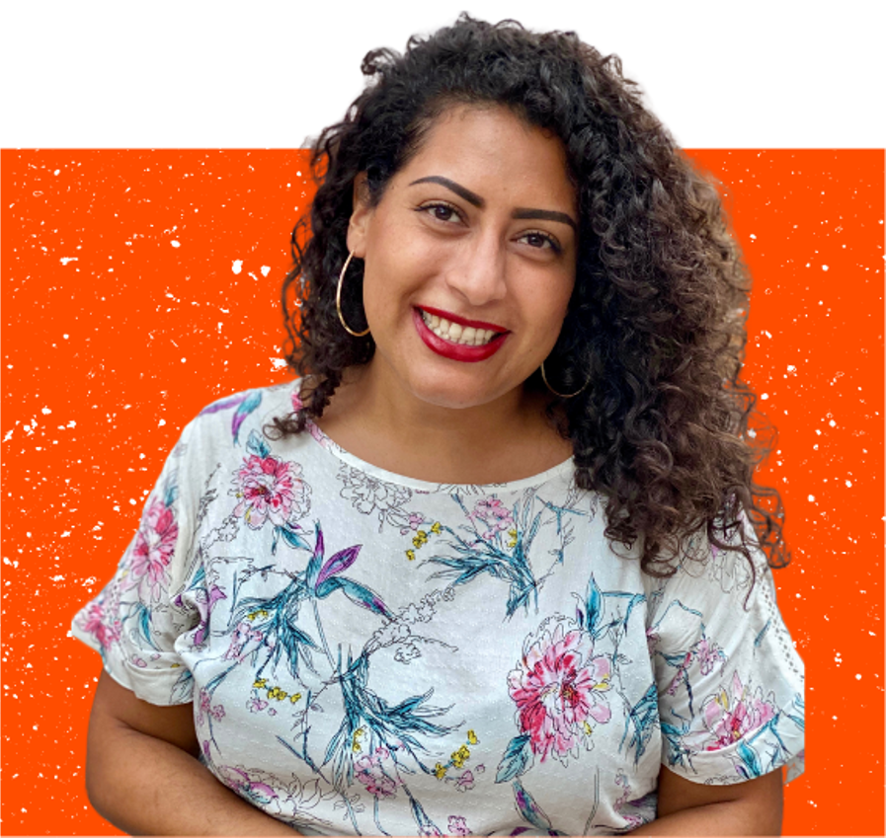
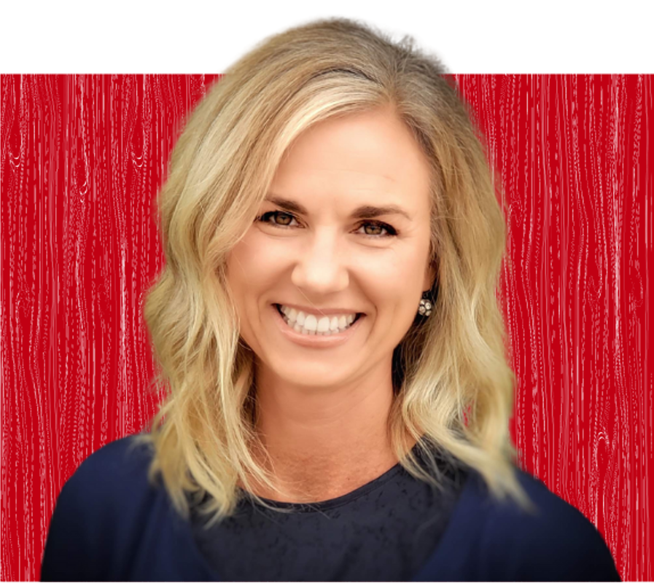
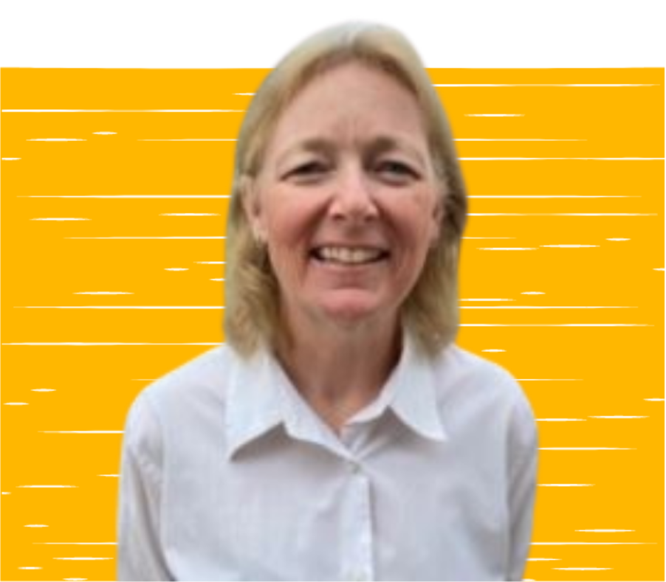
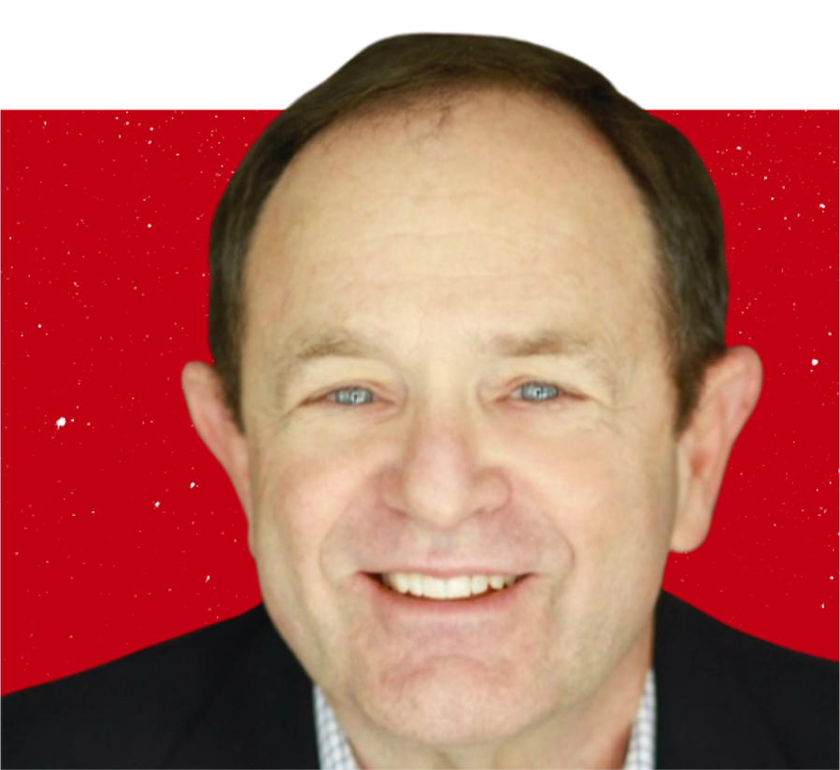
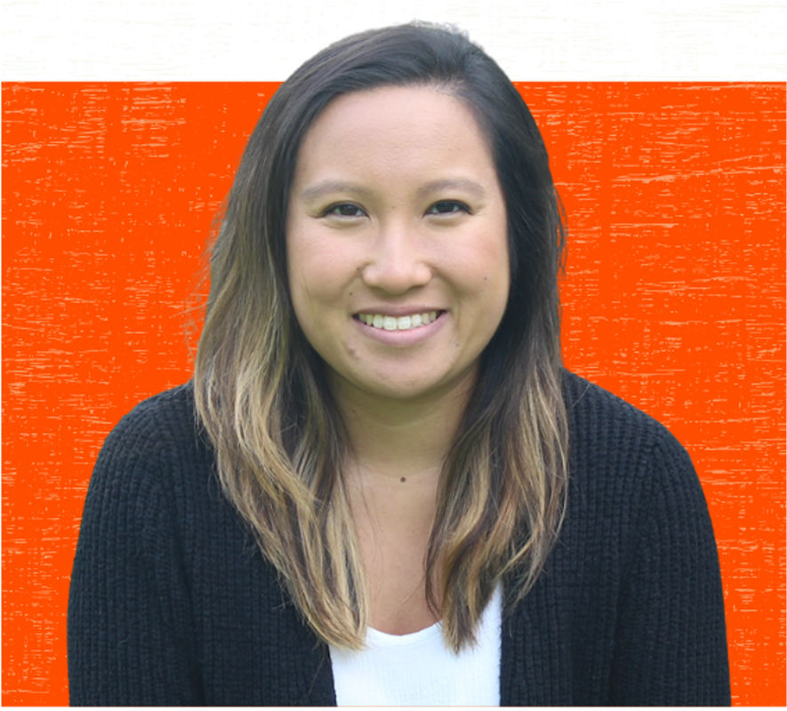
2022 Board of Directors
GWEN FRANCO
BRIDGET RANDALL
KAREN RADZINSKI
President Elect
President
Secretary
DAVID BERKE
MELANIE CHIN
Programs Director
Marketing Director

Slide 9
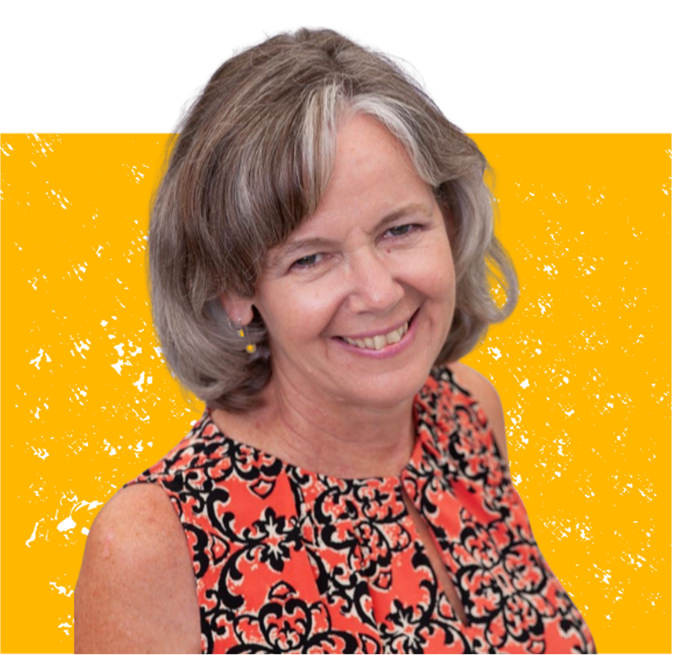
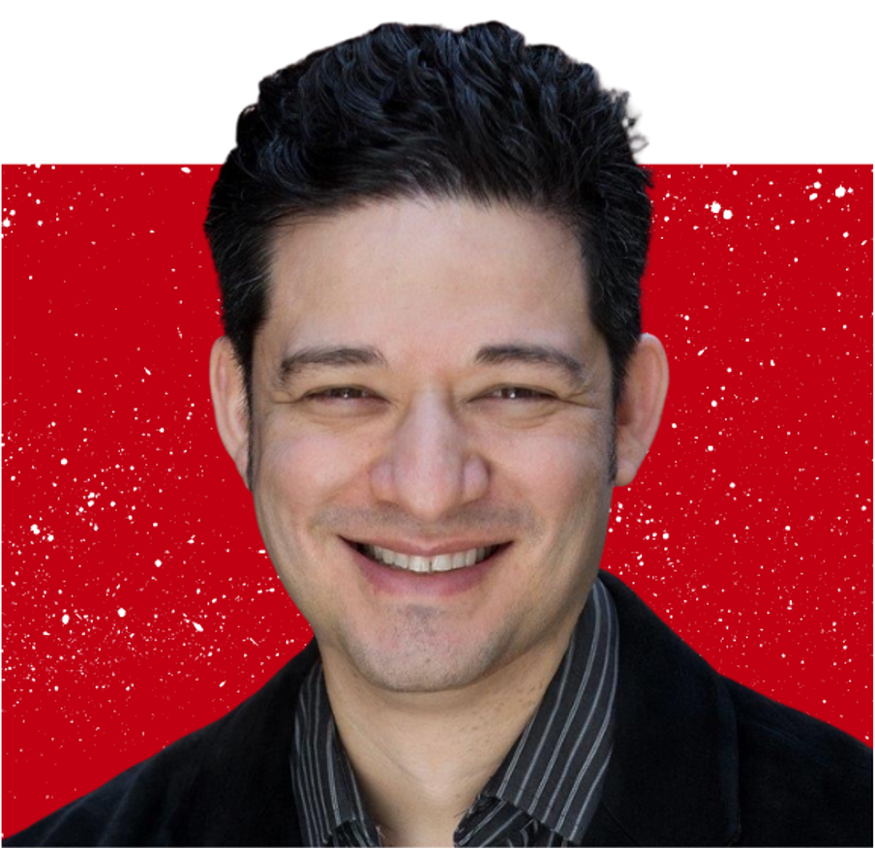
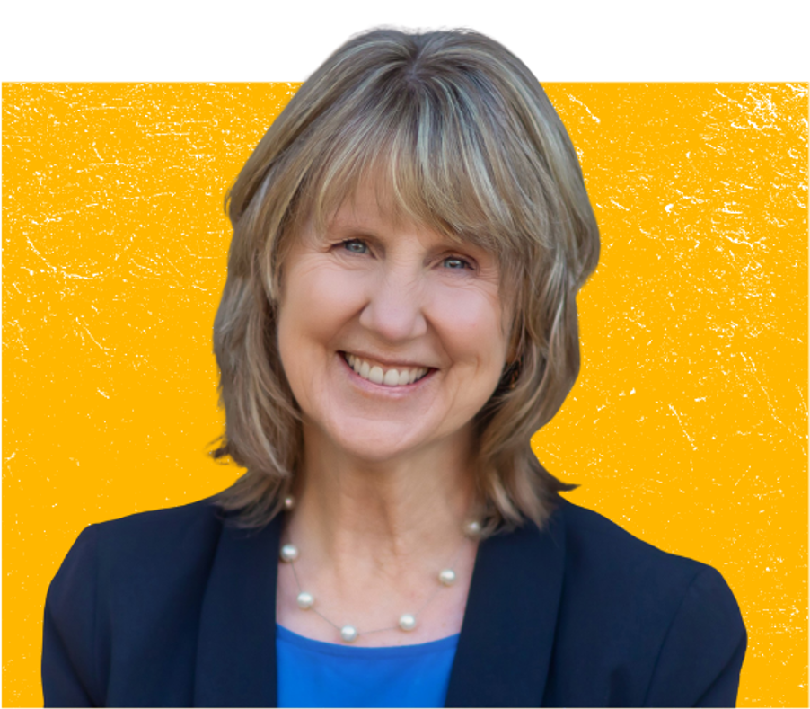
Out Going Board Members
MARY JANE RICCARDI
TOM VELASQUEZ
NORMA HERNANDEZ
Past President
Technology Director
Finance Director
SYLVIA MELINA
MELISSA ESTEN
Programs Director
Membership Director
Notes:
Helpful, but not required
Zoom/tech support during chapter meetings
Nice to have
Video editing of chapter meetings for YouTube posts
Email video recordings to chapter meetings or post vids on YouTube

Slide 10
Opportunities
Technology
Update events on website
Change carousel graphics
Cue event emails
Edit President vLOG
Notes:
Update the events on the website
Update graphics on the website carrousel
Queue emails for events (registration/confirmation/reminders) and event survey email
Make any last minute changes to events such as location, time, etc.
Admin responsibilities of Google Suite (emails, permissions, resetting passwords)

Slide 11
Opportunities
Finance
Collaborate to prepare annual budget
Review contracts & chapter investments
Maintain tax-exempt non-profit status
Notes:
Update the events on the website
Update graphics on the website carrousel
Queue emails for events (registration/confirmation/reminders) and event survey email
Make any last minute changes to events such as location, time, etc.
Admin responsibilities of Google Suite (emails, permissions, resetting passwords)

Slide 12
Opportunities
Membership
Coordinate chapter guides
Plan email renewal reminders
Track the membership dashboard
Assist with Discover the Benefits of Membership sessions
Notes:
Update the events on the website
Update graphics on the website carrousel
Queue emails for events (registration/confirmation/reminders) and event survey email
Make any last minute changes to events such as location, time, etc.
Admin responsibilities of Google Suite (emails, permissions, resetting passwords)

Slide 14
Next Up
New Mixer Locations
South Bay
North County

Slide 15
ATD Capability Model Aligned Programs
CPTD Badges & CPU’s
Earned with your participation

Slide 16
Goals
Special Interest Groups (SIG’s)
Aka Communities of Practice
Mentor Protégé Program
Redesigned

Slide 17
Thank you for your membership

